Slide 1
Personalized Mental Health Prediction for Employees
Presented By
Sai Varun Nimmagadda
Shaheen Chirakula
Vishnu Vikas Nallamalli

Slide 2
Introduction to the Project
What is the project about?
This project aims to explore the state of mental health in the tech industry, analyzing factors that influence whether tech employees seek mental health treatment. The technology industry, known for its high-pressure work environments, long working hours, and competitive culture, is increasingly facing scrutiny for its impact on employee well-being.
Why was this project chosen?
This project was chosen because of its relevance to today’s workplace challenges, particularly in the tech sector where employees experience high levels of stress. With publicly available data and strong potential for real-world impact, this project is both meaningful and feasible.

Slide 3
Overview Of Similar Approaches
There has been growing academic interest in workplace mental health, with studies covering topics such as:
- Burnout in tech and IT sectors (recognized by WHO).
- Remote work and its effect on mental health, especially after COVID-19.
- The role of workplace benefits and company culture in reducing mental health stigma.
Reports from companies such as Google, Microsoft, McKinsey, and Deloitte have highlighted the importance of psychological safety and clear benefits in improving employee mental health. However, most existing studies cover broad industry trends rather than focusing exclusively on the tech sector.
What’s missing is detailed quantitative analysis that links personal factors (family history, personal diagnosis) with workplace factors (company size, remote work, benefits) to predict treatment-seeking behavior.

Slide 4
dataset

Slide 5
What kind of data will be studied?
The project uses the 'Mental Health in Tech' survey dataset, which captures information on:
- Demographics (age, gender, country).
- Workplace conditions (remote work, company size, tech vs non-tech employer).
- Employer policies (mental health benefits, wellness programs, anonymity).
- Personal history (family history, previous diagnosis, current treatment).
- Perceptions and stigma (fear of consequences, comfort discussing issues).
How large is the dataset?
The dataset contains 1433 responses and 63 columns for the year 2016. Our total data that we are going to study is from 2106 to 2021.

Slide 6
Data Source
What is the source of the dataset?
The dataset comes from an open survey conducted to understand mental health challenges faced by employees in the technology sector. It has also been used in public data science competitions.
Dataset:
OSMI Mental health in tech survey-2016 (https://www.kaggle.com/datasets/osmi/mental-health-in-tech-2016) OSMI Mental health in tech survey-2017(https://www.kaggle.com/datasets/osmihelp/osmi-mental-health-in-tech-survey-2017) OSMI Mental health in tech survey-2018(https://www.kaggle.com/datasets/osmihelp/osmi-mental-health-in-tech-survey-2018) OSMI Mental health in tech survey-2019 (https://www.kaggle.com/datasets/osmihelp/osmi-mental-health-in-tech-survey-2019) OSMI Mental health in tech survey-2020 (https://www.kaggle.com/datasets/osmihelp/osmi-2020-mental-health-in-tech-survey-results) OSMI Mental health in tech survey-2021 (https://www.kaggle.com/datasets/osmihelp/osmh-2021-mental-health-in-tech-survey-results)

Slide 7
Research Question / Hypothesis
Research Question: "What factors influence whether a tech employee seeks treatment for mental health issues?"
Hypothesis: "Employees with access to mental health benefits, open workplace cultures, and supportive supervisors are more likely to seek treatment. Conversely, stigma, fear of professional consequences, and lack of awareness reduce treatment rates."

Slide 8
Literature and Industry Research
j
What have others done on this topic?
The intersection of mental health and workplace conditions has received increasing attention in recent years. Several studies, reports, and industry whitepapers have explored this topic. Below are some notable examples:
Study | Key Insights
WHO Burnout Classification (2019) | Classified burnout as an occupational phenomenon, highlighting the importance of workplace factors in mental health.
Eurofound Report on Telework and Mental Health (2021) | Found that remote work can increase isolation and stress, contributing to mental health struggles.
"Tech Industry Burnout: Causes and Solutions" (Harvard Business Review, 2020) | Emphasized that high workloads and "always-on" culture contribute to deteriorating mental health in tech.

Slide 9
What’s Missing?
Most studies focus on broad industry trends — very few focus specifically on tech.
Research often lacks quantitative correlation analysis between company policies and treatment-seeking behavior.
Few studies cross-analyze personal history (family history, previous diagnosis) with work environment to predict mental health outcomes.
Data-driven analysis linking remote work, company size, and tech culture directly to treatment-seeking rates is underexplored.

Slide 10
How This Project is Different
j
Aspect | Our Project
Focus | Exclusively focused on the tech industry workforce.
Data Depth | Combines personal history, employer policies, work conditions, and perceptions all in one dataset.
Analytical Approach | Uses statistical analysis, correlations, and visualization, moving beyond simple qualitative conclusions.
Outcome | Generates actionable insights for HR teams and leadership in tech companies to design better mental health policies.

Slide 11
Implementation Plan
Step | Activity | Tools/Methods
1 | Data Collection | Download/open the Mental Health in Tech dataset
2 | Data Exploration | Check structure, types, missing values, distributions
3 | Data Cleaning | Handle missing values, inconsistent categories, encoding
4 | Encoding | Convert categorical fields (like Yes/No values) to numeric codes, save mapping
5 | Exploratory Data Analysis | Distribution plots, comparisons (treatment vs no treatment), correlations
6 | Hypothesis Testing | Compare treatment rates across factors (gender, remote work, benefits)
7 | Visualization | Generate presentation-ready chart
8 | Reporting | Document all findings into a structured report

Slide 12
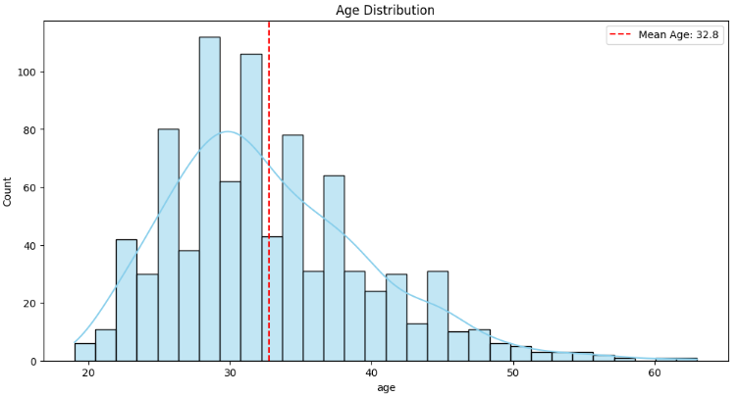
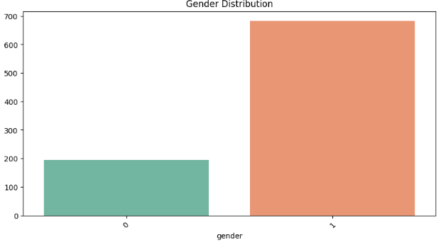
Exploratory Data Analysis

Slide 13
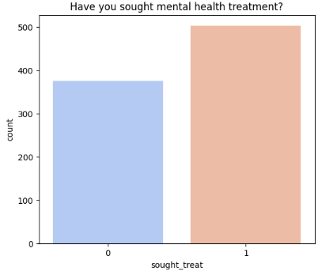
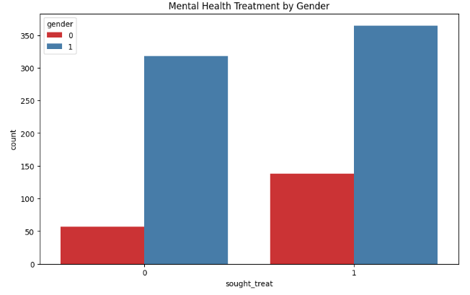

Slide 14
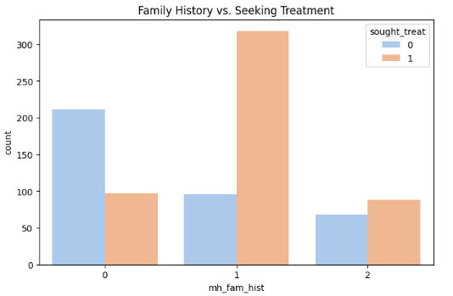
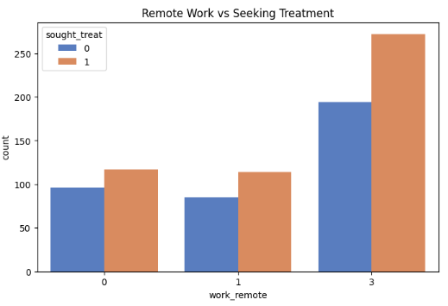

Slide 15
Summary of Basic EDA (Exploratory Data Analysis)
j
Analysis | Key Findings
Age Distribution | Most respondents are aged 25-35, reflecting the younger workforce in tech.
Gender Split | Skewed towards male respondents, typical of tech surveys.
Treatment Rates | Approximately half of respondents have sought treatment for mental health.
Family History | Having a family history of mental illness significantly increases treatment-seeking rates.
Remote Work Impact | Remote workers report slightly higher treatment rates, possibly due to isolation or flexible schedules enabling care.
Mental Health Benefits | Employees with mental health benefits are much more likely to seek treatment — showing how corporate policy directly affects mental health care access.

Slide 16
Thank you

